Slide 1
Introduction to Statistical Methods
ISM Team

Slide 2
Session No 3
Bayes Theorem , Random Variables
(Session 3: 21st /22nd May 2022)

Slide 3
Session No 3 Course Handout
Contact Session | List of Topic Title | Reference
CS - 3 | Random Variables – Discrete & Continuous (single variable) | T1:Chapter 3 & 4
HW | Problems on Random Variables | T1:Chapter 3 & 4
Lab

Slide 4

Agenda
Here is what you learn in the entire session
1
Definition of Random variables and Different types
2
Discrete and Continuous Probability Distributions

Slide 5
⸪ No changes in each of the data (Constant)
⸪ Changes in each of the data (Variable)
No
Meaning/ Definition
Variable
Yes
In which of the following data it is possible to apply any Statistical Methods to summarize?
Height (cms) by 10 persons
168, 168, 168, 168, 168, 168, 168, 168, 168, 168
Height (cms) by 10 persons
168, 165, 178, 166, 158, 181, 154, 170, 168, 178

Slide 6
Let us explore the reasons after a while
Discrete (ex. Countable #s)
Continuous (ex. Real #s)
Yes/No (Why?)
Variable
Meaning/ Definition
Statistical Methods are possible to apply only if the data varies (Variable).
Can the data on height (cms) be called random variable?
Like Height, other measurements viz., Weight, Age, BP, Wages etc are also called variables, usually denoted by X, Y, Z etc

Slide 7
If a computer chip is selected at random,
the sample space will be Ω
If two computer chip is selected at
random, the sample space will be Ω
# of events = 2¹ = 2
# of events = 2² = 4
Variable
Meaning/ Definition
Example 1
Ω = {N, D}
Example 2
Ω = {NN, ND, DN, DD}

Slide 8
If three computer chips are selected at
random, the sample space will be Ω
If four computer chips are selected at
random, the sample space will be Ω
Variable
Meaning/ Definition
Example 3
Ω = {NNN, NND, NDN, DNN, NDD, DND, DDN, DDD}
# of events = 2³ = 8
Example 4
Ω = {NNNN, NNND,…, NNDN, NDDN,…,DNDN, NDDD,…DNDD, DDDD}
# of events = 2⁴ = 16

Slide 9
Variable
Meaning/ Definition
If the number of Computer chips selected are 5, 6, …, n, the size of the sample space also increases 2⁵ = 32, 2⁶ = 64, …, 2^{n}.
Basically, instead of how many events in a Ω are there
we are interested in counting a # of times a favourable event occurs like No. of defective chips

Slide 10
If a computer chip is selected at random,
the sample space will be Ω
If two computer chip is selected at
random, the sample space will be Ω
No. of defective chips
Ω = {0, 1, 1, 2}
Ω = {0, 1}
Meaning/ Definition
Variable
Example 1
Ω = {N, D}
Example 2
Ω = {NN, ND, DN, DD}
Favourable event (# of defectives)

Slide 11
If three computer chips are selected at
random, the sample space will be Ω
If four computer chips are selected at
random, the sample space will be Ω
No. of defective chips
Variable
Meaning/ Definition
Example 3
Ω = {NNN, NND, NDN, DNN, NDD, DND, DDN, DDD }
Ω = {0, 1, 1, 1, 2, 2, 2, 3 }
Example 4
Pascal triangle
Ω = {NNNN, NNND,…, NNDN, NDDN,…,DNDN, NDDD,…DNDD, DDDD}
Ω = {0, 1, 1, 1, 1, 2, 2, 2, 2, 2, 2, 3, 3, 3, 3, 4 }

Slide 12
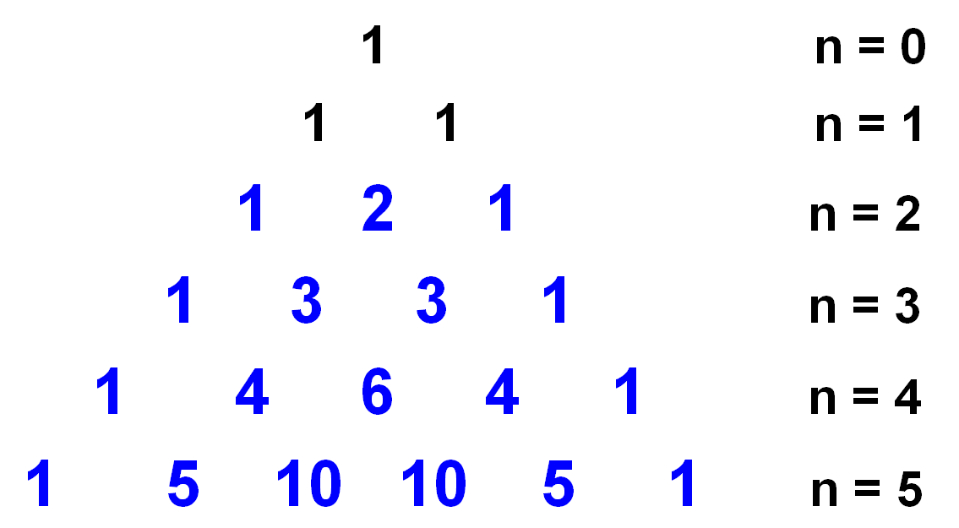
Meaning/ Definition
Variable
Pascal triangle

Slide 13
Meaning/ Definition
Variable
Let us denote the counting numbers based on the defined favourable event by X, Y, Z etc.
X, Y, Z are called Random variable
The examples of Height, Weight, Age, BP, Wages which are denoted as X, Y, Z, are called Variables whereas in case of example on Computer chips X, Y, Z are called Random variables.
What is the difference between the two?

Slide 14
Random Variable
Explanation – Every value of X based on some chance
Example 1
Outcome | X | Favourable events (m) | Probability
N | 0 | 1 | 1/2
D | 1 | 1 | 1/2
Total |  | 2 | 1
Outcome | X | m | Frequency (f) | Probability
NN | 0 | 1 | 1 | 1/4
ND | 1 | 1 | 2 | 2/4
DN | 1 | 1
DD | 2 | 1 | 1 | 1/4
Total |  | 4 | 4 | 1
Example 2

Slide 15
Random variable
Explanation – Every value of X based on some chance
Example 3
Outcome | X | m | f | Probability
NNN | 0 | 1 | 1 | 1/8
NND | 1 | 1 | 3 | 3/8
NDN | 1 | 1
DNN | 1 | 1
NDD | 2 | 1 | 3 | 3/8
DND | 2 | 1
DDN | 2 | 1
DDD | 3 | 1 | 1 | 1/8
Total |  | 8 | 8 | 1

Slide 16
Random variable
Probability Distribution
Example 1
For each value taken by X, there is a probability associated called probability mass. Why?
X | 0 | 1 | Total
Frequency | 1 | 1 | 2
P(X=x) | 0.50 | 0.50 | 1
Example 2
X | 0 | 1 | 2 | Total
Frequency | 1 | 2 | 1 | 4
P(X=x) | 0.25 | 0.50 | 0.25 | 1
Example 3
X | 0 | 1 | 2 | 3 | Total
Frequency | 1 | 3 | 3 | 1 | 8
P(X=x) | 0.125 | 0.375 | 0.375 | 0.125 | 1
Example 4
X | 0 | 1 | 2 | 3 | 4 | Total
Frequency | 1 | 4 | 6 | 4 | 1 | 16
P(X=x) | 0.0625 | 0.2500 | 0.3750 | 0.2500 | 0.0625 | 1

Slide 17
Random variable
Probability Distribution
A random variable is a real valued function defined on the sample space Ω
With the introduction of X we can write the probabilities as
p(0) = P(X=0) = 0.0625
p(1) = P(X=1) = 0.2500
p(2) = P(X=2) = 0.3750
p(3) = P(X=3) = 0.2500
p(4) = P(x=4) = 0.0625 such that
p(0) + p(1) + p(2) + p(3) + p(4) = 1
and each p(x) ≥ 0, x = 0, 1, 2, 3, 4
Ω
X: Ω→R
R
0
1
2
3
4
0.0625
0.2500
0.3750

Slide 18
Continuous
Discrete
Random variable
Definition
A random variable is a real valued function which is a mapping from the sample space Ω to the set of real numbers, ie., X: Ω→R. There are two types viz.,

Slide 19


Types of Random Variables
Discrete random variables
Number of sales
Number of calls
Shares of stock
People in line
Mistakes per page
Continuous random variables
Length
Depth
Volume
Time
Weight

Slide 20
Random variable
Types of random variables
Two types of random variables
Discrete random variable:
A random variable which take on countable numbers (may be finite or countable infinite values) i.e., without decimal like Natural #s, Whole #s, Integers etc.
Continuous random variable:
A random variable which take on any values in an interval i.e., in the set of real #s which includes, negative, positive, rational, irrational, decimal etc

Slide 21
Random variable
Probability distributions based on RVs
Two types of Probability distributions
Discrete Probability Distribution:
A probability distribution based on discrete random variable is called discrete probability distribution.
Continuous Probability Distribution:
A probability distribution based on continuous random variable is called continuous probability distribution

Slide 22
Discrete Probability Distribution

Slide 23
Probability Distribution
Meaning/ Definition
Age (yrs) | No. of Persons
≤ 1 | 141
2-5 | 187
6-12 | 206
13-19 | 353
20-29 | 365
30-39 | 386
40-49 | 269
50-60 | 63
> 60 | 30
Total | 2000
No. of defective RAM chips (X) | Probability
0 | 0.0625
1 | 0.2500
2 | 0.3750
3 | 0.2500
4 | 0.0625
Total | 1
Frequency distribution
Probability distribution

Slide 24

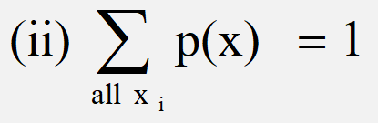
A random variable ‘X’ is said to have
discrete probability distribution if it satisfy
the following conditions
p(x) = P(X=x) is
called probability
mass function
(pmf)
Probability Distribution
Definition and Properties
Definition

Slide 25
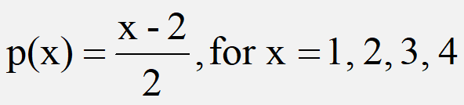

Check whether the following can serve as
Probability distributions
For what value of
c, this can be a
probability mass
function (pmf)?
Probability Distribution
Discrete distribution
Example
No
Yes
with
c =1/30

Slide 26
Probability Distribution
Discrete distribution
No. of defective RAM chips | Probability
0 | ⅛
1 | ⅜
2 | ⅜
3 | ⅛
Total | 1

Slide 27
Probability Distribution
Discrete distribution
X = No. of defectives
X | 0 | 1 | 2 | 3
P(X=x) | 0.614 | 0.324 | 0.057 | 0.003

Slide 28
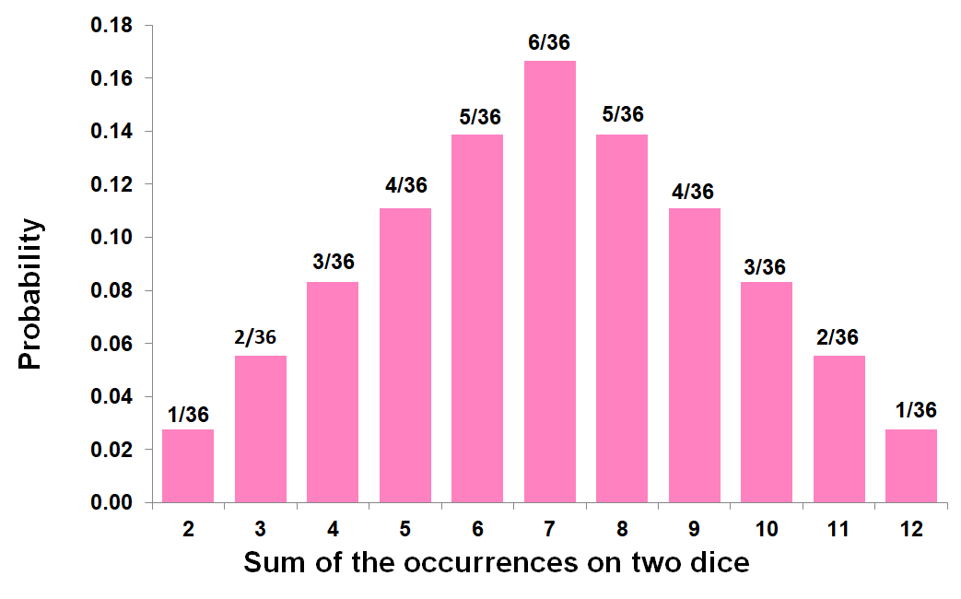
Probability Distribution
Discrete distribution
Example 2:
Let X denote the random variable that is defined as the sum of two fair dice, then,
X=x | 2 | 3 | 4 | 5 | 6 | 7 | 8 | 9 | 10 | 11 | 12
P(X=x) | 1/36 | 2/36 | 3/36 | 4/36 | 5/36 | 6/36 | 5/36 | 4/36 | 3/36 | 2/36 | 1/36

Slide 29
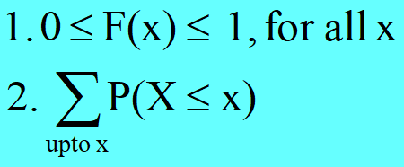
Probability Distribution
Cumulative Distribution Function
Let p(x) =P(X=x) is called a (discrete) probability distribution.
Let F(x) = P(X ≤ x). F(x) is called the Cumulative Distribution Function or Distribution Function (DF) of the discrete random variable X. F(x) has the following properties

Slide 30
Probability Distribution
Cumulative Distribution Function
No. of defective RAM chips | Probability | Cumulative probability
0 | 0.125 | 0.125
1 | 0.375 | 0.500
2 | 0.375 | 0.875
3 | 0.125 | 1.000
Total | 1

Slide 31
Probability Distribution
Discrete distribution function
Probability distributions can be estimated from relative frequencies. Consider the discrete (countable) number of televisions per household (X) from India survey data …
No. of televisions | No. of households | X | P(x)
0 | 1,218 | 0 | 0.012
1 | 32,379 | 1 | 0.319
2 | 37,961 | 2 | 0.374
3 | 19,387 | 3 | 0.191
4 | 7,714 | 4 | 0.076
5 | 2,842 | 5 | 0.028
Total | 101,501 |  | 1.000
1,218 ÷ 101,501
= 0.012
e.g. P(X=4) = P(4) = 0.076 =7.6%

Slide 32
Probability Distribution
Discrete distribution function
What is the probability there is at least one television but no more than three in any given household?
No. of televisions | No. of households | X | P(x)
0 | 1,218 | 0 | 0.012
1 | 32,379 | 1 | 0.319
2 | 37,961 | 2 | 0.374
3 | 19,387 | 3 | 0.191
4 | 7,714 | 4 | 0.076
5 | 2,842 | 5 | 0.028
Total | 101,501 |  | 1.000
“at least one television but no more than three”
P(1 ≤ X ≤ 3) = P(1) + P(2) + P(3) = 0.319 + 0.374 + 0.191 = 0.884

Slide 33
Probability Distribution
Cumulative Distribution Function
Let X denote the number of tires on a randomly
selected automobile that are underinflated.
(a) Which of the following three probability mass
functions is legitimate for X and why are the other or
not allowed?
X = x | 0 | 1 | 2 | 3 | 4
p₁(x) = P(X=x) | 0.30 | 0.20 | 0.10 | 0.05 | 0.05
p₂(x) = P(X=x) | 0.40 | 0.10 | 0.10 | 0.10 | 0.30
p₃(x) = P(X=x) | 0.40 | - 0.10 | 0.20 | 0.10 | 0.30

Slide 34
Probability Distribution
Cumulative Distribution Function
X = x | 0 | 1 | 2 | 3 | 4
p(x) = P(X=x) | 0.40 | 0.10 | 0.10 | 0.10 | 0.30
(b) For legitimate pmf of part (a),
compute (i) P (X ≤ 2), (ii) P (2 ≤ X ≤ 4)
and (iii) P (X ≠ 0)
(c) If p (x) = c(5-x), x = 0, 1, 2, 3, 4
what is the value of c?

Slide 35
Probability Distribution
Cumulative Distribution Function
A mail-order computer business has six telephone lines. Let X
denote the number of lines in use at a specified time. Suppose that
the pmf is as follows:
X = x | 0 | 1 | 2 | 3 | 4 | 5 | 6
p(x) = P(X=x) | 0.10 | 0.15 | 0.20 | 0.25 | 0.20 | 0.06 | 0.04
Calculate the probability that
(a) At most 3 lines are in use
(b) Fewer than 3 line in use
(c) At least 3 lines are in use
(d) Between 2 and 5 lines are in use
(e) At least four lines are not in use

Slide 36
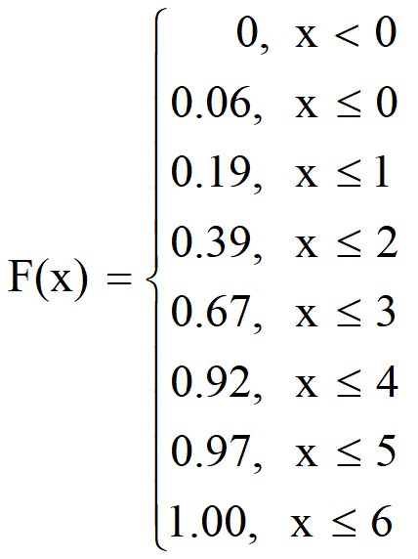
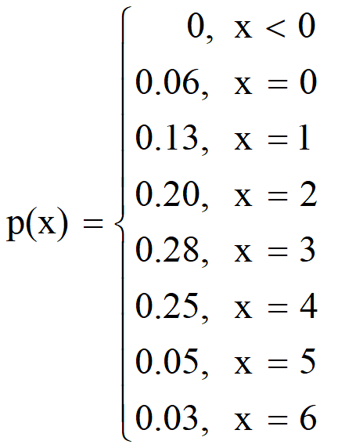
Probability Distribution
Cumulative Distribution Function
Find the probability mass function from a given
distribution function of X
P(X) = F(X) – F(X-1)

Slide 37
Probability Distribution
Discrete Distribution
How do you describe this frequency distribution?
Wages of employees (Rs) | 4001- 4500 | 4501- 5000 | 5001- 5500 | 5501- 6000 | 6001- 6500 | 6501- 7000 | 7001- 7500 | 7501- 8000 | 8001- 8500 | Total
No. of persons | 25 | 36 | 45 | 62 | 39 | 55 | 44 | 29 | 15 | 350
Measures of central tendency – Mean, Median
Measures of dispersion – Range, SD, IQR, Skewness

Slide 38
Probability Distribution
Expected value and Variance
How do you describe this probability distribution?
Measures of central tendency – Expectation (Expected value)
Measures of dispersion – Variance

Slide 39
Probability Distribution
Expected value and Variance
Like mean and standard deviation are computed to describe data measured by quantitative variable, a similar measures viz., expected value (mean) and variance for random variable X are computed for describing the probability distribution using the formula
Central measure and Measure of Spread
E(X)
E(X²)
V(X)

Slide 40
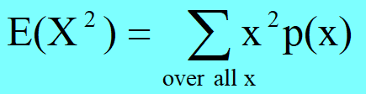
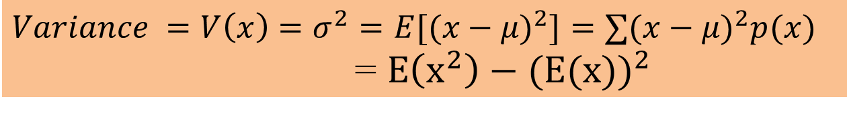
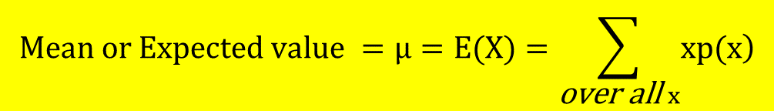
Probability Distribution
Expected value and Variance
For a discrete random variable X with probability mass function p(x),
$$Mean or Expected value =µ=E(X)=\sum_{\text{over} \text{all} x}{\left.xp(x\right)}$$
$Variance =V\left(x\right)=σ^{2}=E[(x−μ)^{2}]=∑(x−μ)^{2}p(x)$
= $E\left(x^{2}\right)−({E(x))}^{2}$
$$Standard deviation σ=√V(x)$$

Slide 41


Probability Distribution
Expected value and Variance
How do you describe this probability distribution?
$$E\left(X\right)=0+0.13+0.40+0.84+1.00+0.25+0.18=2.8$$
$$E\left(X^{2}\right)=0+0.13+0.80+2.52+4.00+1.25+1.08=9.18$$
$$V\left(X\right)=E\left(X^{2}\right)−({E(X))}^{2}$$
$$V\left(X\right)=9.18−{(2.8}^{2})=1.94$$

Slide 42
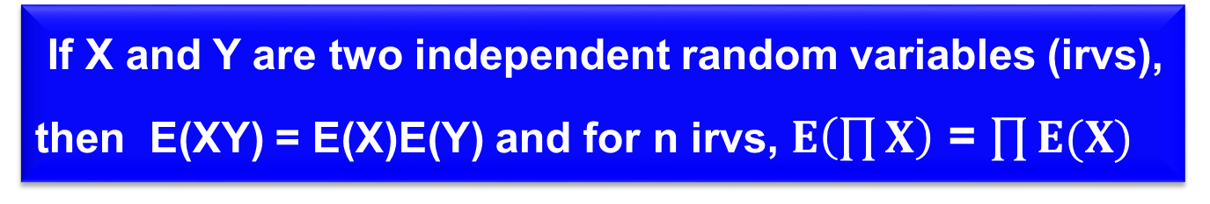
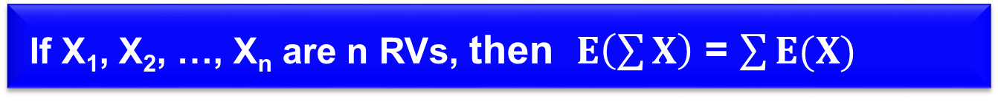
Probability Distribution
Expected value and Variance
Properties of Expectation
If ‘k’ is a constant, then E(k) = k and E(kX) = kE(X), X is an rv
If X and Y are two random variables E(X±Y) = E(X)±E(Y)
If X₁, X₂, …, X_{n} are n RVs, then $E\left(\sum{X}\right)$ = $\sum{E(X)}$
If X and Y are two independent random variables (irvs), then E(XY) = E(X)E(Y) and for n irvs, $E\left(\prod{X}\right)$ = $\prod{E(X)}$

Slide 43
Probability Distribution
Expected value and Variance
Properties of Variance
If ‘k’ is a constant, then V(k) = 0 and V(kX) = k²V(X), X is an rv
Given V(X), for Y = a + bX, then V(Y) = b²V(X)
If X and Y are two random variables then
V(X±Y) = V(X) + V(Y) ± Cov (X, Y)
If X and Y are independent random variables (irvs), then V(X±Y) = V(X) + V(Y)

Slide 44
Probability Distribution
Expected value and Variance
Let X be a discrete random variable having the probability mass function
X = x | 0 | 1 | 2 | 3 | 4 | 5 | 6 | 7
# Registered | 150 | 450 | 1950 | 3750 | k | 2550 | 1500 | 300
Find the value of k
Find the probability distribution function of X
Calculate E(X) and V(X)
Assume N = 15000

Slide 45
Continuous Probability Distribution

Slide 46
A continuous random variable can assume any value in an interval on the real line or in a collection of intervals.
It is not possible to talk about the probability of the random variable assuming a particular value.
Instead, we talk about the probability of the random variable assuming a value within a given interval.
Probability Distribution
Continuous probability distribution
Definition

Slide 47
The probability of the random variable assuming a value within some given interval from x₁ to x₂ is defined to be the area under the graph of the probability density function between x₁ and x₂.
The probability of the continuous random variable assuming a specific value is 0.
Probability Distribution
Continuous probability distribution
Definition

Slide 48
The probability that a random variable X assumes different values x in a given interval, say (a, b), is denoted by f(x) = P(a ≤ X ≤ b), called probability density function (pdf).
A random variable is called continuous when it assumes values in a given interval.
Probability Distribution
Continuous probability distribution
Definition

Slide 49
A continuous random variable can assume any value in an interval on the real line or in a collection of intervals.
It is not possible to talk about the probability of the random variable assuming a particular value.
Instead, we talk about the probability of the random variable assuming a value within a given interval.
Probability Distribution
Continuous probability distribution
Introduction

Slide 50
The probability of the random variable assuming a value within some given interval from x₁ to x₂ is defined to be the area under the graph of the probability density function between x₁ and x₂.
The probability of the continuous random variable assuming a specific value is 0.
Probability Distribution
Continuous probability distribution
Introduction

Slide 51
The probability that a random variable X assumes different values x in a given interval, say (a, b), is denoted by f(x) = P(a ≤ X ≤ b), called probability density function (pdf).
A random variable is called continuous when it assumes values in a given interval.
Probability Distribution
Continuous probability distribution
Introduction

Slide 52
Probability Distribution
Continuous probability distribution
a
x₁
x₂
b
a
x₁
b
P(x₁ ≤ x ≤ x₂)
P(x ≤ x₁)
pdf
P(x ≥ x₁)= 1- P(x ≤ x₁)
a
x₁
b
P(x ≥ x₁)

Slide 53
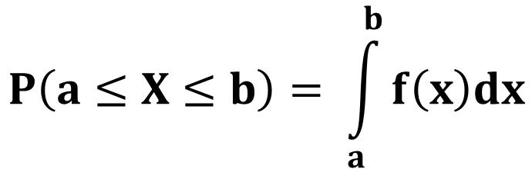
Probability Distribution
Continuous probability distribution
Indeed, the probabilities are the area under the curve in a given interval. Thus, a function with values f(x)
defined over the set of all real numbers (a, b) is given
by
$$P\left(a≤X≤b\right)= \int_{a}^{b}{f\left(x\right)dx}$$

Slide 54
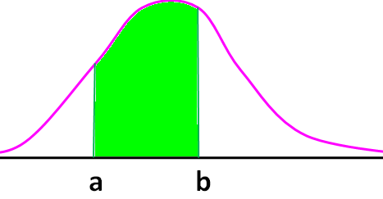
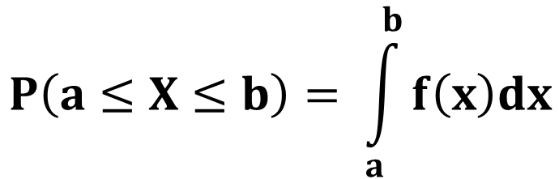
Probability Distribution
Continuous probability distribution
Introduction
$$P\left(a≤X≤b\right)= \int_{a}^{b}{f\left(x\right)dx}$$

Slide 55
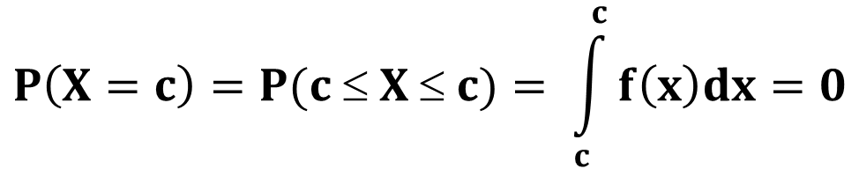
Probability Distribution
Continuous probability distribution
It is important to note that f(c), the value of the pdf of X at a constant c does not give P(X=c) as in the discrete case and in continuous case probabilities are always associated with intervals and P(X=c) = 0. That is
$$P\left(X=c\right)=P(c ≤ X ≤ c)= \int_{c}^{c}{f\left(x\right)dx=0}$$

Slide 56


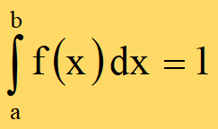
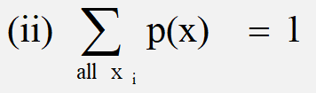
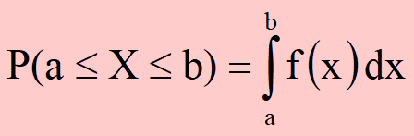
Probability Distribution
Continuous probability distribution
An f(x) is called a probability density function of a continuous
random variable if it satisfy the following properties
Discrete probability distribution

Slide 57
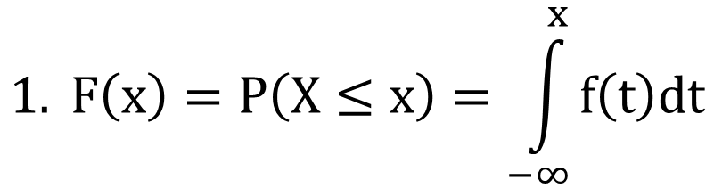

Probability Distribution
Continuous probability distribution
Let F(x) = P(X ≤ x). F(x) is called the Distribution Function (DF) of the continuous random variable X. F(x) has the following properties.
where f(x) is called probability density function.
$$1. F\left(x\right)=P\left(X≤x\right)=\int_{−∞}^{x}{f\left(t\right)dt}$$
$$2. 0≤F\left(x\right)≤1$$

Slide 58
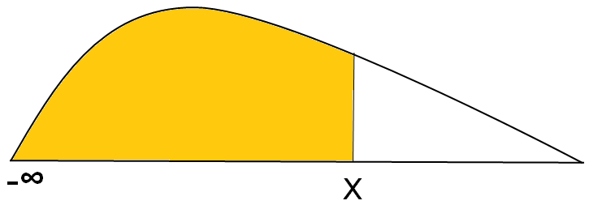
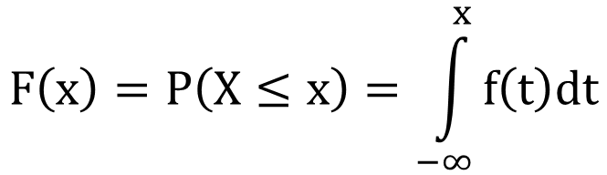
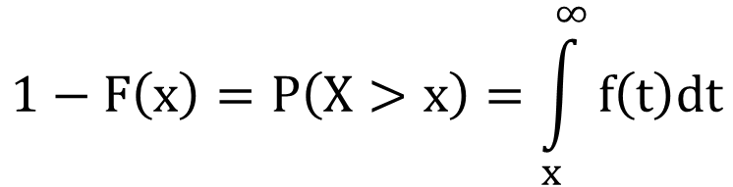
Probability Distribution
Continuous probability distribution
$$1−F\left(x\right)=P\left(X>x\right)=\int_{x}^{∞}{f\left(t\right)dt}$$
∞
$$F\left(x\right)=P\left(X≤x\right)=\int_{−∞}^{x}{f\left(t\right)dt}$$

Slide 59
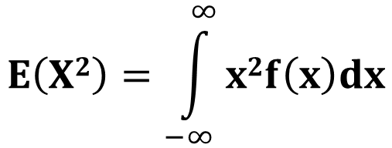
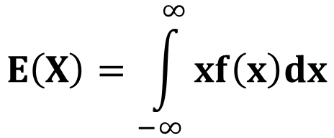

Probability Distribution
Continuous probability distribution
As in case of discrete probability distribution, the expected value E(X) and variance V(X) can be computed for the continuous probability distribution
$$E\left(X\right)=\int_{−∞}^{∞}{xf\left(x\right)dx}$$
$$E\left(X2\right)=\int_{−∞}^{∞}{x2f\left(x\right)dx}$$
$$V\left(X\right)={E(X}^{2})−{(E\left(X\right))}^{2}$$

Slide 60
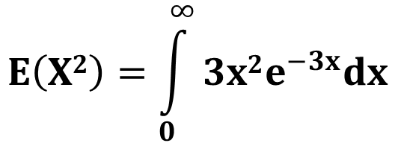
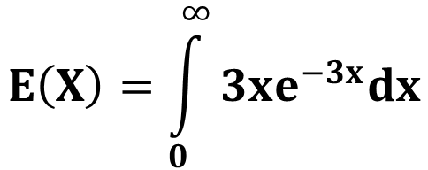
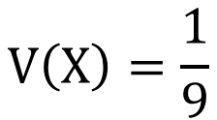
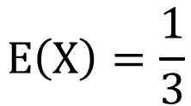

Probability Distribution
Continuous probability distribution
If f(x) = 3e^{-3x}, x>0
Find E(X) and V(X)
$$E\left(X\right)=\int_{0}^{∞}{3xe^{−3x}dx}$$
$$E\left(X2\right)=\int_{0}^{∞}{3x2e^{−3x}dx}$$
$$V\left(X\right)={E(X}^{2})−{(E\left(X\right))}^{2}$$
$$E\left(X\right)=\frac{1}{3}$$
$$V\left(X\right)=\frac{1}{9}$$

Slide 61
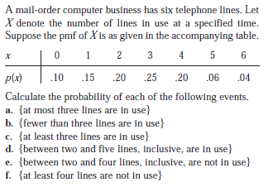
Homework Problems
Book T1: Section 3.2, Ex 13

Slide 62
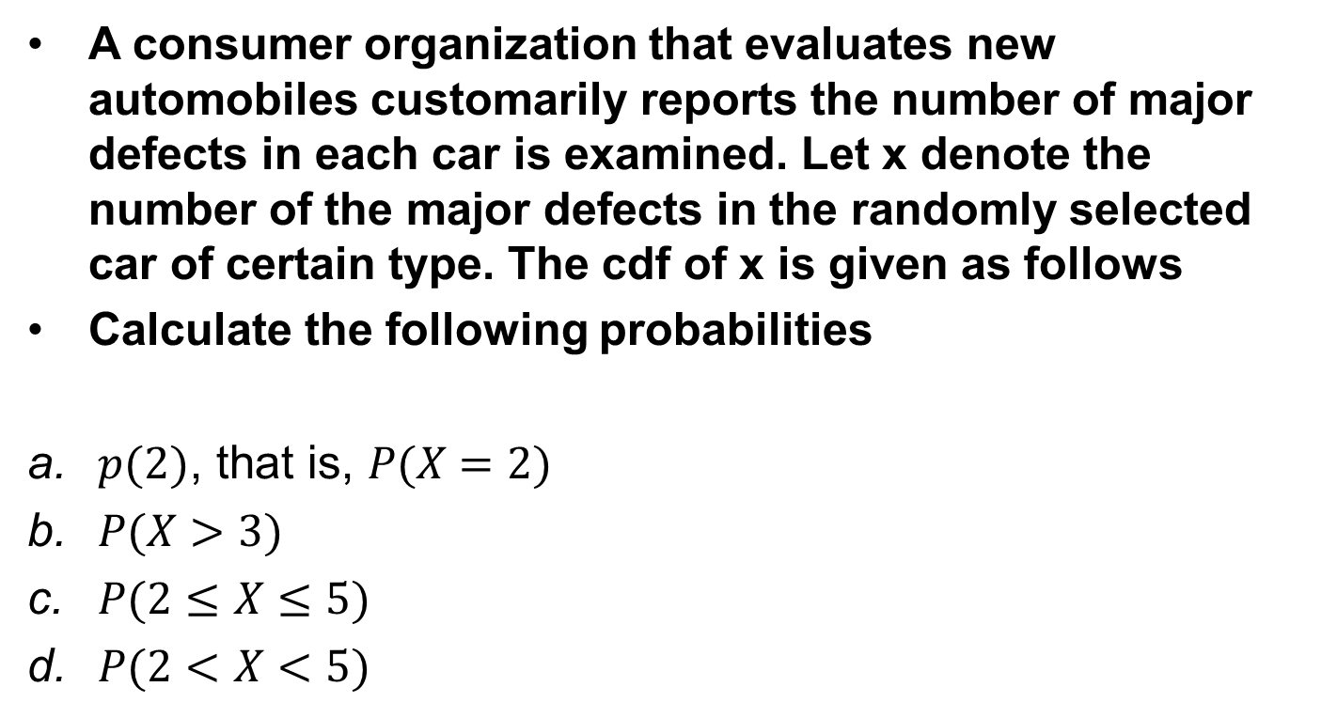
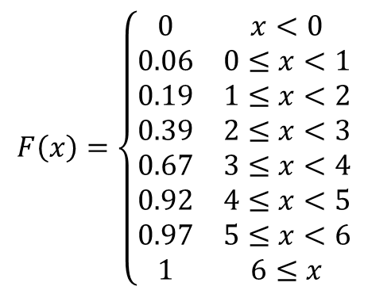
Homework Problems
Book T1: Section 3.2, Ex 23
A consumer organization that evaluates new automobiles customarily reports the number of major defects in each car is examined. Let x denote the number of the major defects in the randomly selected car of certain type. The cdf of x is given as follows
Calculate the following probabilities
$p(2)\text{, }\text{that} \text{is}\text{, }P(X=2)$
$P(X>3)$
$P(2≤X≤5)$
$P(2<X<5)$
$$F\left(x\right)=\left\{\begin{matrix}0 & x<0 \\ 0.06 & 0≤x<1 \\ 0.19 & 1≤x<2 \\ 0.39 & 2≤x<3 \\ 0.67 & 3≤x<4 \\ 0.92 & 4≤x<5 \\ 0.97 & 5≤x<6 \\ 1 & 6≤x\end{matrix}\right.$$

Slide 63
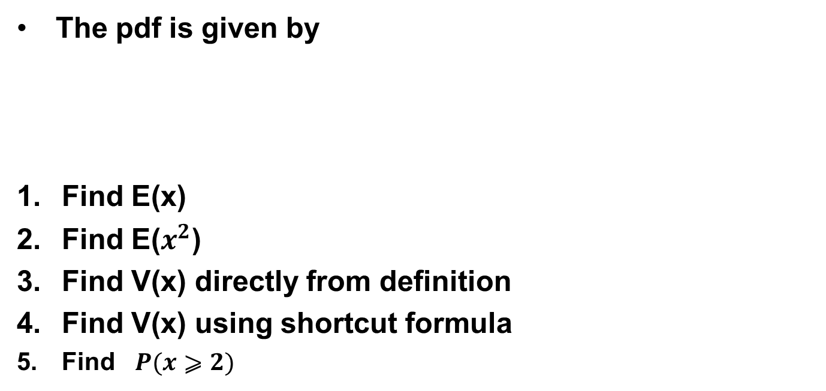
Homework Problems
Book T1: Section 3.3, Ex 29
The pdf is given by
Find E(x)
Find E($x^{2}$)
Find V(x) directly from definition
Find V(x) using shortcut formula
Find $P(x⩾2)$
x | 1 | 2 | 4 | 8 | 16
P(x) | 0.05 | 0.10 | 0.35 | 0.40 | 0.10

Slide 64
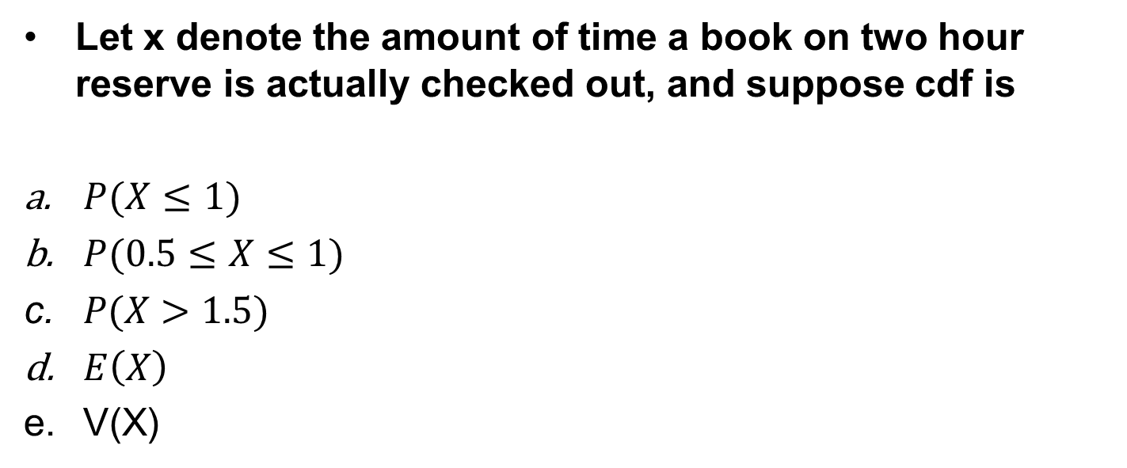
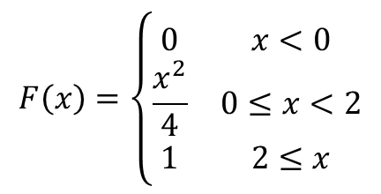
Homework Problems
Book T1: Section 4.2, Ex 11
Let x denote the amount of time a book on two hour reserve is actually checked out, and suppose cdf is
$P(X≤1)$
$P(0.5≤X≤1)$
$P(X>1.5)$
$E\left(X\right)$
V(X)
$$F\left(x\right)=\left\{\begin{matrix}0 & x<0 \\ \frac{x^{2}}{4} & 0≤x<2 \\ 1 & 2≤x\end{matrix}\right.$$

Slide 65
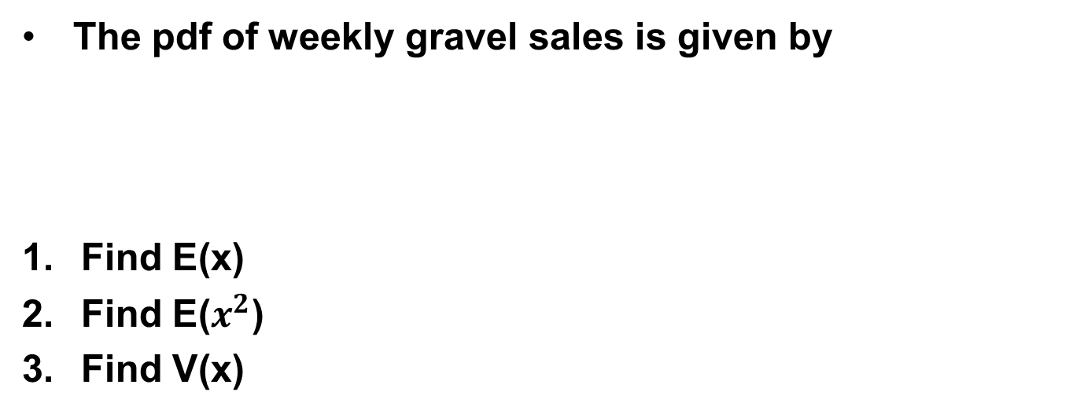
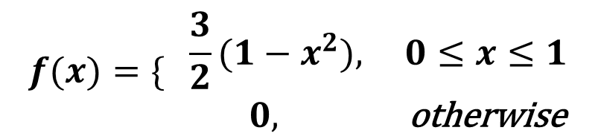
Homework Problems
Probability distribution
The pdf of weekly gravel sales is given by
Find E(x)
Find E($x^{2}$)
Find V(x)
$$f(x)=\{\begin{matrix} \frac{3}{2}(1−x^{2}), & 0≤x≤1 \\ 0, & \text{otherwise} \end{matrix}$$

Slide 66
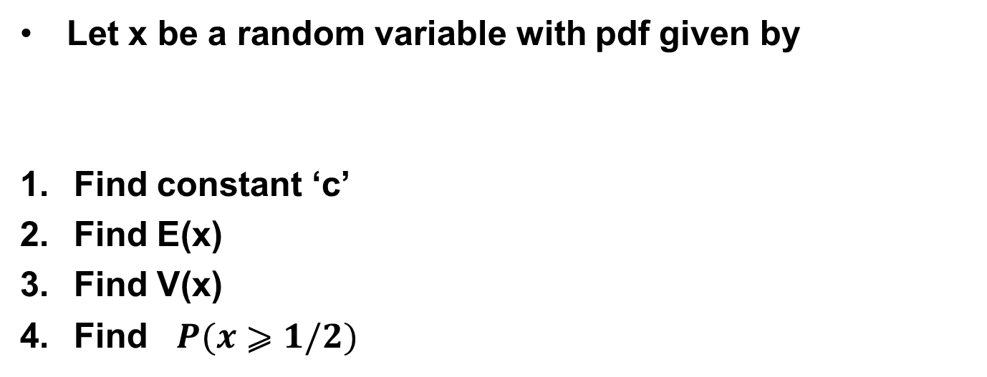
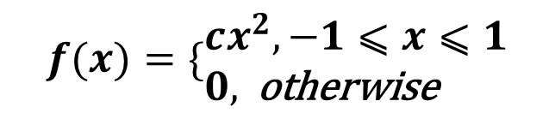
Homework Problems
Probability distribution
Let x be a random variable with pdf given by
Find constant ‘c’
Find E(x)
Find V(x)
Find $P(x⩾1/2)$
$$f(x)=\{\begin{aligned}&cx^{2},−1⩽x⩽1 \\ &0, \text{otherwise} \end{aligned}$$

Slide 67
Thanks

